Slide 1
Pipeline and Vector Processing
Based on M. Morris Mano “Computer System Architecture”-- Lecturer Ahmed Salah Hameed

Slide 2
Parallel Processing
Parallel processing is a term used to denote a large class of techniques that are used to provide simultaneous data processing tasks for the purpose of increasing the computational speed of a computer system.
concurrent data processing to achieve faster execution.
The purpose:
Speed up the computer processing capability
Increase the throughput
Throughput the amount of processing that can be accomplished during a given interval of time.
The side effects
The amount of hardware increases
The cost of the system increases
Based on M. Morris Mano “Computer System Architecture”-- Lecturer Ahmed Salah Hameed

Slide 3
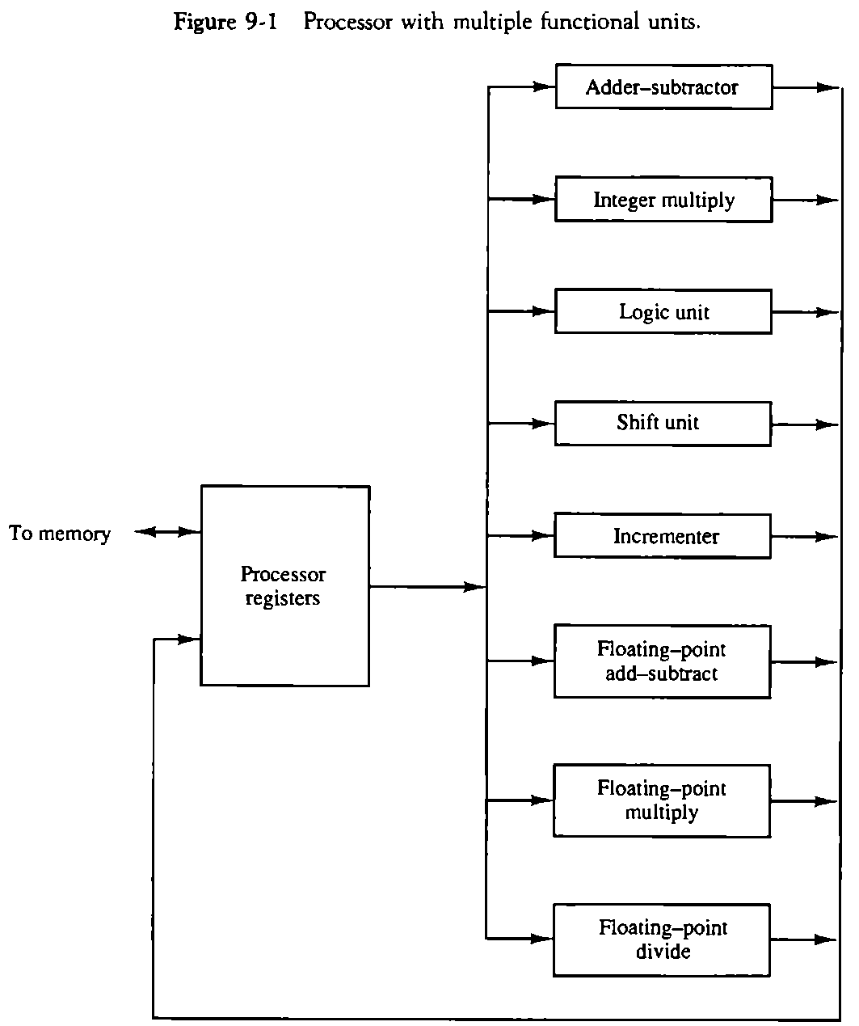
Parallel processing / levels of complexity
At the lower level
Serial Shift register VS parallel load registers
At the higher level
Multiplicity of functional units that perform identical or different operations simultaneously.
Based on M. Morris Mano “Computer System Architecture”-- Lecturer Ahmed Salah Hameed

Slide 4
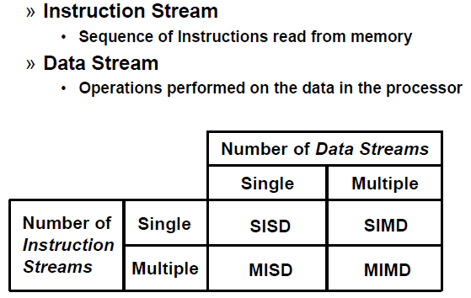
Parallel processing or parallel computers
It can be considered
from the internal organization of the processors
from the interconnection structure between processors
or from the flow of information through the system.
Flynn's classification
Based on M. Morris Mano “Computer System Architecture”-- Lecturer Ahmed Salah Hameed

Slide 5
Flynn's classification
SISD
SIMD
Based on M. Morris Mano “Computer System Architecture”-- Lecturer Ahmed Salah Hameed

Slide 6
Flynn's classification
3. MISD
4. MIMD
Based on M. Morris Mano “Computer System Architecture”-- Lecturer Ahmed Salah Hameed

Slide 7
Main topics of the Chapter
Pipeline processing : Sec. 9-2
Arithmetic pipeline : Sec. 9-3
Instruction pipeline : Sec. 9-4
Vector processing : adder/multiplier pipeline , Sec. 9-6
Array processing : array processor , Sec. 9-7
Attached array processor : Fig. 9-14
SIMD array processor : Fig. 9-15
Based on M. Morris Mano “Computer System Architecture”-- Lecturer Ahmed Salah Hameed

Slide 8
Pipelining
Pipelining is a technique of decomposing a sequential process into sub operations, with each sub process being executed in a special dedicated segment that operates concurrently with all other segments.
A pipeline can be visualized as a collection of processing segments through which binary information flows.
The name “pipeline” implies a flow of information analogous to an industrial assembly line.
Based on M. Morris Mano “Computer System Architecture”-- Lecturer Ahmed Salah Hameed

Slide 9
Example of the Pipeline Organization
Based on M. Morris Mano “Computer System Architecture”-- Lecturer Ahmed Salah Hameed

Slide 10
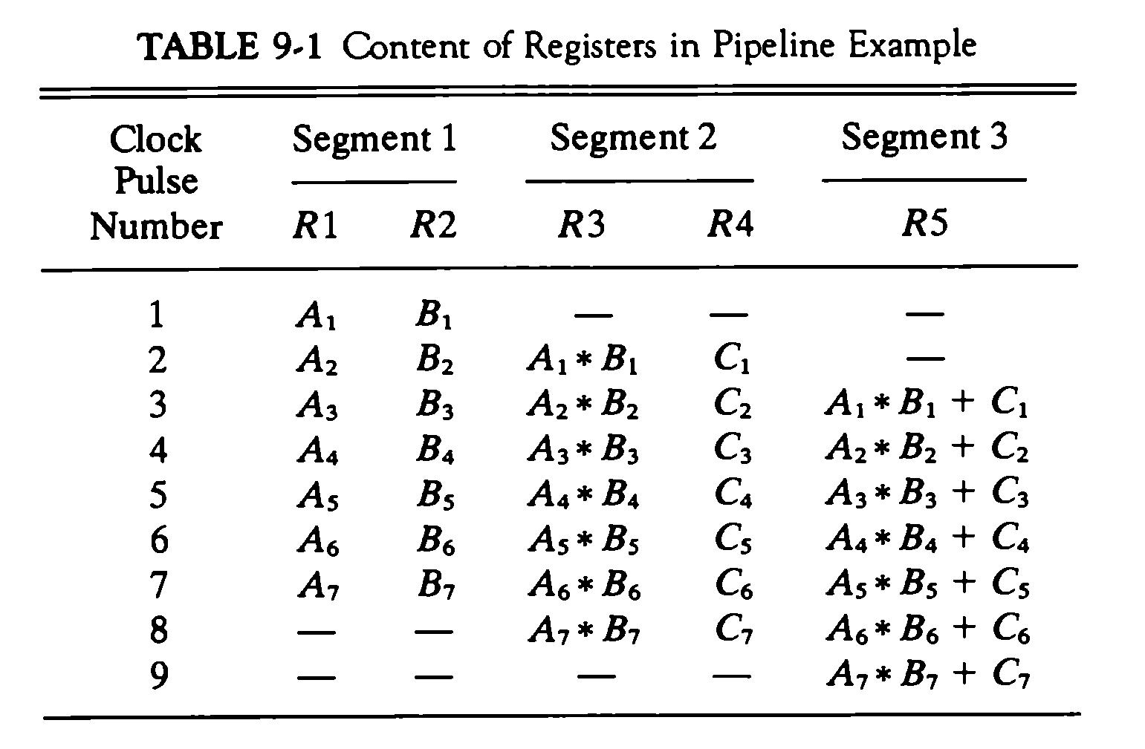
Example of the Pipeline Organization
Based on M. Morris Mano “Computer System Architecture”-- Lecturer Ahmed Salah Hameed

Slide 11
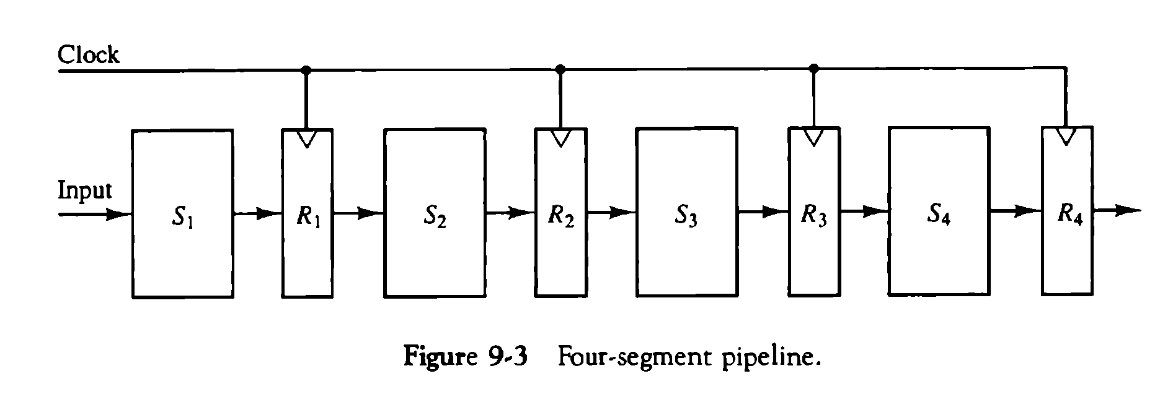
GENERAL PIPELINE
Any operation that can be decomposed into a sequence of sub operations of about the same complexity can be implemented by a pipeline processor.
The technique is efficient for those applications that need to repeat the same task many times with different sets of a task as the total operation performed going through all the segments in the pipeline.
Based on M. Morris Mano “Computer System Architecture”-- Lecturer Ahmed Salah Hameed

Slide 12
SPEED CALCULATION
K-segment pipeline with a clock cycle time (tp) is used to execute n tasks.
The first task T1 requires a time equal to (k*tp) to complete its operation because we have k segments in the pipe.
The remaining n - 1 tasks emerge from the pipe at the rate of one task per clock cycle and they will be completed after a time equal to (n - 1)*tp.
Therefore, to complete n tasks using a k-segment pipeline:
k + (n - 1) clock cycles
For example system with four segments and six tasks.
The time required to complete all the operations is/
4 + (6 - 1) = 9 clock cycles
Based on M. Morris Mano “Computer System Architecture”-- Lecturer Ahmed Salah Hameed

Slide 13
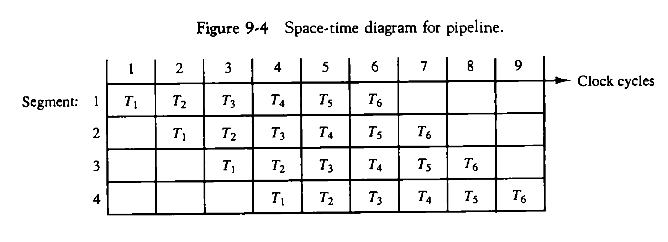
SPEED CALCULATION
Based on M. Morris Mano “Computer System Architecture”-- Lecturer Ahmed Salah Hameed

Slide 14
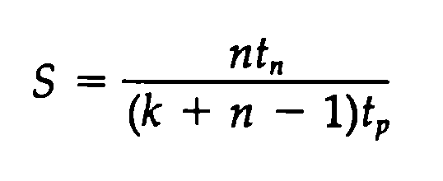
SPEED CALCULATION
NONPIPELINE UNIT
Each task take time equal to tn.
The total time required for n tasks is
n * tn
PIPELINE UNIT
To complete n tasks using a k-segment pipeline:
k + (n - 1) clock cycles
Total time is: k + (n - 1) * tp
SPEED UP
Based on M. Morris Mano “Computer System Architecture”-- Lecturer Ahmed Salah Hameed

Slide 15
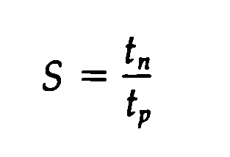
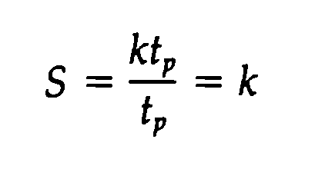
SPEED CALCULATION
NOTES
As the number of tasks increases, n becomes much larger than k - 1, and k + n - 1 approaches the value of n. Under this condition, the speedup becomes:
If we assume that the time it takes to process a task is the same in the pipeline and nonpipeline circuits, we will have tn = k*tp. So the speedup reduces to:
Based on M. Morris Mano “Computer System Architecture”-- Lecturer Ahmed Salah Hameed

Slide 16
EXAMPLE ON SPEED CALCULATION
Based on M. Morris Mano “Computer System Architecture”-- Lecturer Ahmed Salah Hameed

Slide 17
ARITHMETIC PIPELINE
Pipeline arithmetic units are usually found in very high speed computers. They are used to implement floating-point operations, multiplication of fixed-point numbers, and similar computations encountered in scientific problems.
EXAPLE:
FLOATING POINT ADDER
Based on M. Morris Mano “Computer System Architecture”-- Lecturer Ahmed Salah Hameed

Slide 18
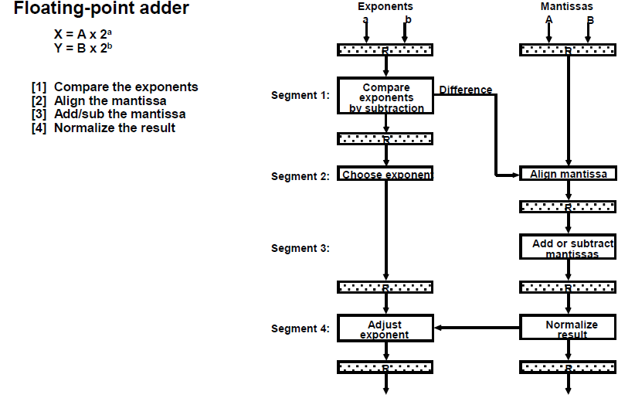
ARITHMETIC PIPELINE
Based on M. Morris Mano “Computer System Architecture”-- Lecturer Ahmed Salah Hameed

Slide 19
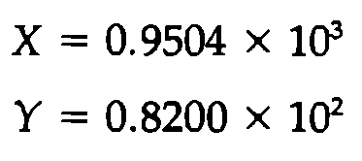
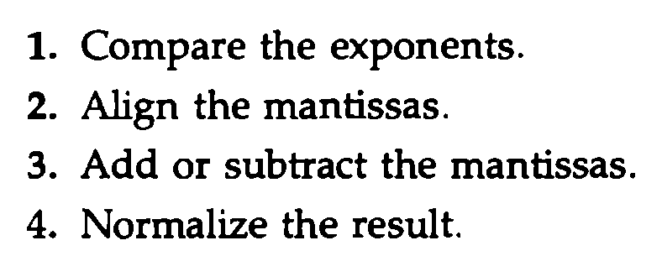
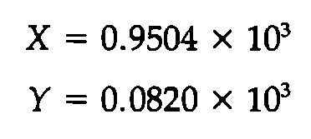
ARITHMETIC PIPELINE
Based on M. Morris Mano “Computer System Architecture”-- Lecturer Ahmed Salah Hameed

Slide 20
ARITHMETIC PIPELINE EXAMPLE
Suppose that the time delays of the four segments are as following:
t1 = 60 ns
t2 = 70 ns
t3 = 100 ns
t4 = 80 ns
the interface registers have a delay of tr = 10 ns.
Pipeline
The clock cycle is chosen to be:
tp = t3 + tr = 110 ns.
Non Pipeline
Delay time tn = t1 + t2 + t3 + t4 + tr = 320 ns.
Speed up
the pipelined adder has a speedup of 320/110 = 2.9 over the non pipelined adder.
Based on M. Morris Mano “Computer System Architecture”-- Lecturer Ahmed Salah Hameed

Slide 21
INSTRUCTION PIPELINE
An instruction pipeline reads consecutive instructions from memory while previous instructions are being executed in other segments. This causes the instruction fetch and execute phases to overlap and perform simultaneous operations.
Simple Example:
Consider a computer with an instruction fetch unit and an instruction execution unit designed to provide a two-segment pipeline.
2-segment pipelined Non pipelined
1 | 2 | 3 | 4
F | E
 | F | E
 |  | F | E
1 | 2 | 3 | 4 | 5 | 6
F | E
 |  | F | E
 |  |  |  | F | E
Based on M. Morris Mano “Computer System Architecture”-- Lecturer Ahmed Salah Hameed

Slide 22
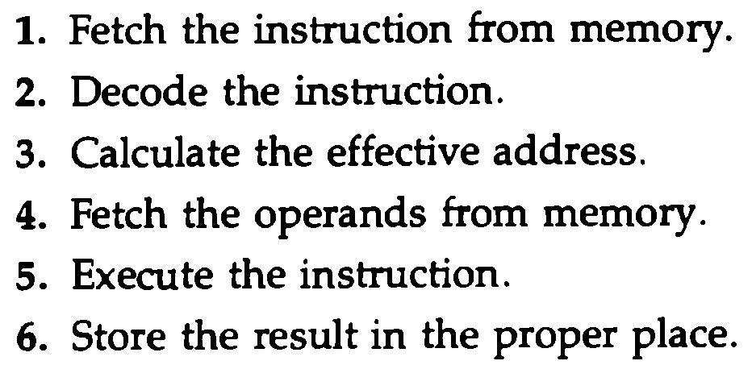
INSTRUCTION PIPELINE
NOTE 1: Computers with complex instructions require other phases in addition to the fetch and execute to process an instruction completely.
NOTE 2: Difficulties that will prevent the instruction pipeline from operating at its maximum rate.
Different segments may take different times to operate on the incoming information.
Some segments are skipped for certain operations. For example, a register mode instruction does not need an effective address calculation.
Two or more segments may require memory access at the same time, causing one segment to wait until another is finished with the memory.
Based on M. Morris Mano “Computer System Architecture”-- Lecturer Ahmed Salah Hameed

Slide 23
INSTRUCTION PIPELINE
NOTE 3: Memory access conflicts are sometimes resolved by using two memory buses for accessing instructions and data in separate modules. In this way, an instruction word and a data word can be read simultaneously from two different modules.
NOTE 4: The design of an instruction pipeline will be most efficient if the instruction cycle is divided into segments of equal duration. The time that each step takes to fulfill its function depends on the instruction and the way it is executed.
Based on M. Morris Mano “Computer System Architecture”-- Lecturer Ahmed Salah Hameed

Slide 24
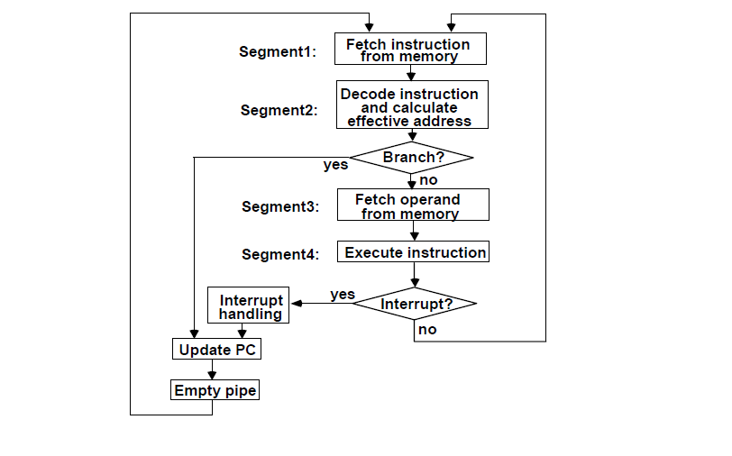
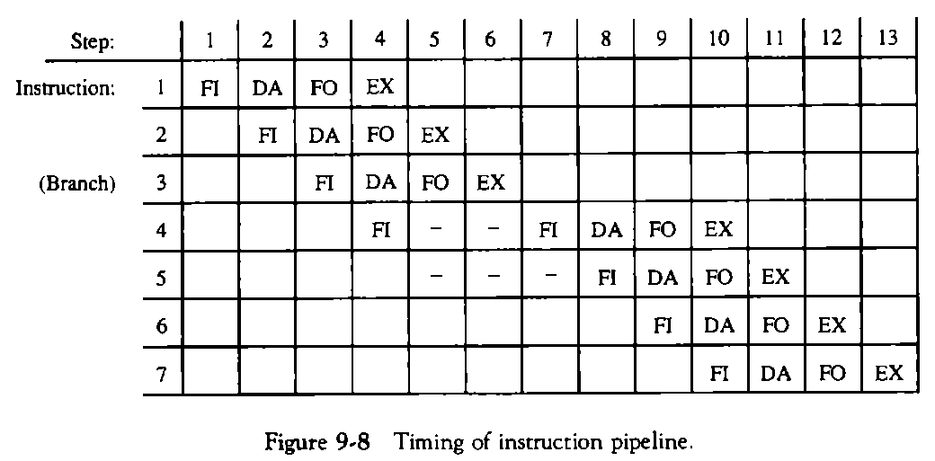
EXAMPLE: FOUR-SEGMENT INSTRUCTION PIPELINE
1. FI is the segment that fetches an instruction.
2. DA is the segment that decodes the instruction and calculates the effective address.
3. FO is the segment that fetches the operand.
4. EX is the segment that executes the instruction.
Based on M. Morris Mano “Computer System Architecture”-- Lecturer Ahmed Salah Hameed

Slide 25
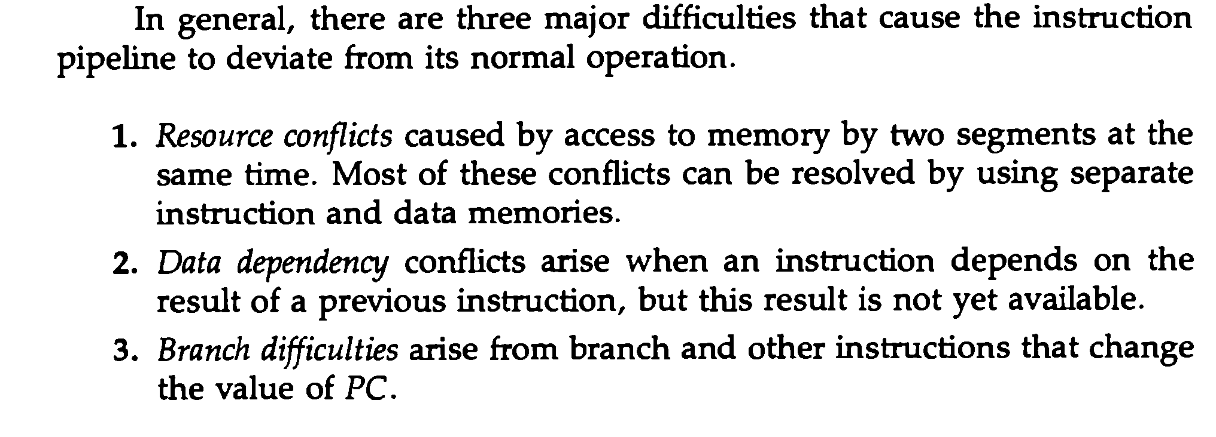
CONFLICTS OF INSTRUCTION PIPELINE
Based on M. Morris Mano “Computer System Architecture”-- Lecturer Ahmed Salah Hameed

Slide 26
DATA DEPENDENCY
Based on M. Morris Mano “Computer System Architecture”-- Lecturer Ahmed Salah Hameed

Slide 27
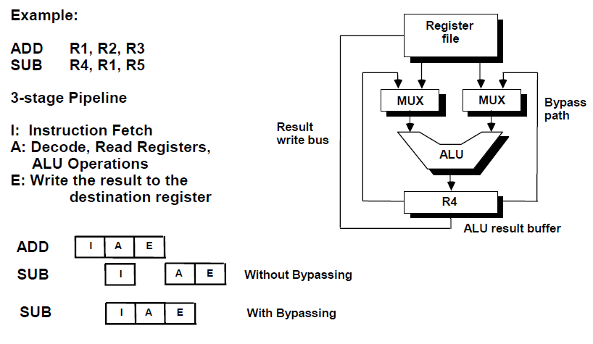
OPERAND FORWARDING
Based on M. Morris Mano “Computer System Architecture”-- Lecturer Ahmed Salah Hameed

Slide 28
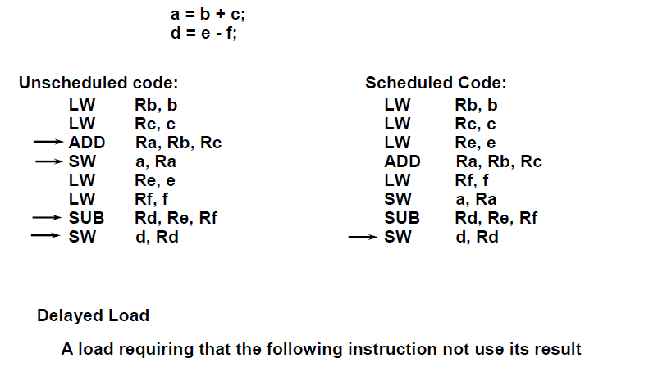
DELAYED LOAD
Based on M. Morris Mano “Computer System Architecture”-- Lecturer Ahmed Salah Hameed

Slide 29
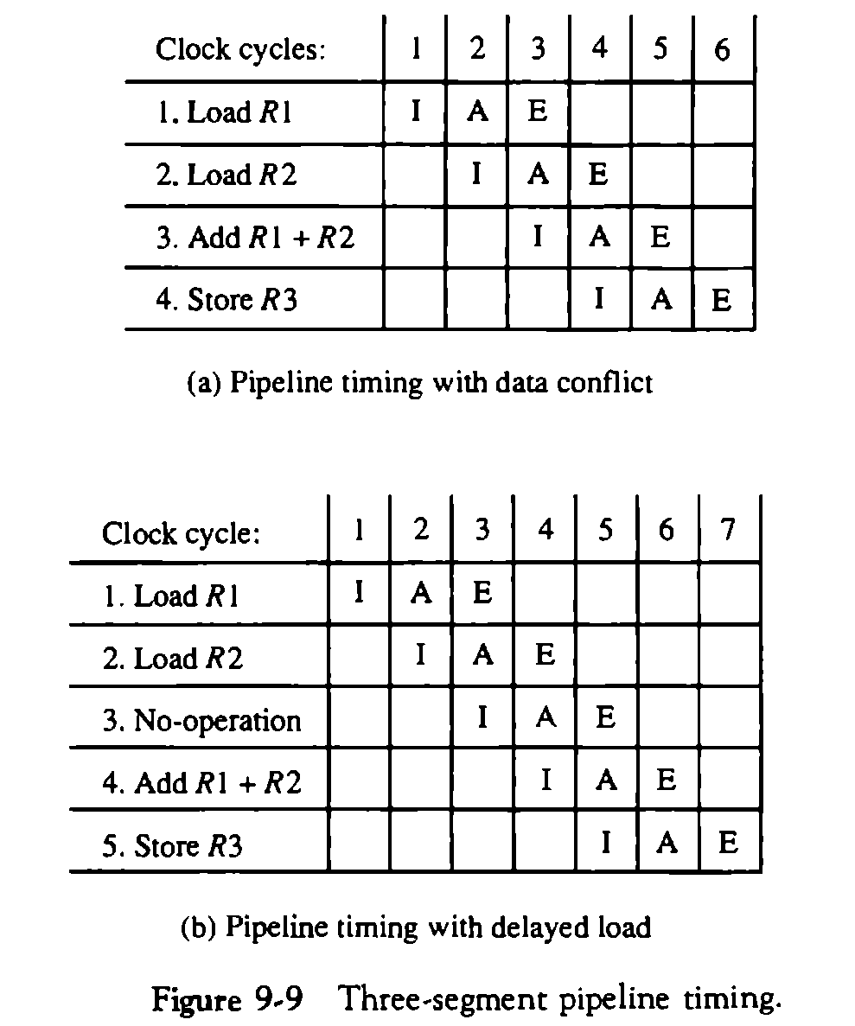
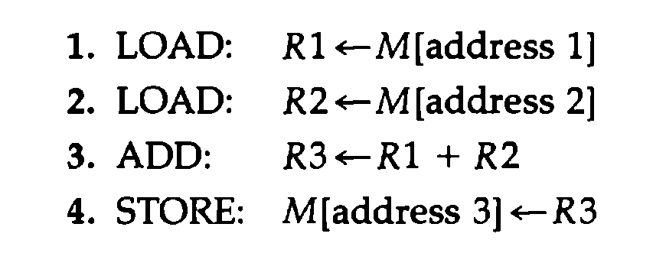
DELAYED LOAD
Based on M. Morris Mano “Computer System Architecture”-- Lecturer Ahmed Salah Hameed

Slide 30
HANDLING OF BRANCH INSTRUCTIONS
Based on M. Morris Mano “Computer System Architecture”-- Lecturer Ahmed Salah Hameed

Slide 31
HANDLING OF BRANCH INSTRUCTIONS
Prefetch the target instruction
Instruction in addition to the instruction following the branch. Both are saved until the branch is executed.
The control chooses the instruction stream of the correct program flow and discard the other one.
Branch Target Buffer or BTB
The BTB is an associative memory included in the fetch segment of the pipeline.
Entry: Store the address of a previously executed branch instruction, the target instruction for that branch, and the next few instructions after the branch target instruction.
When fetching and decoding instruction, it searches the BTB for the address of the instruction:
If it is in the BTB, fetch it from the BTB.
If the instruction is not in the BTB, fetch it from memory and update the BTB.
The advantage of this scheme is that branch instructions that have occurred previously are readily available in the pipeline without interruption.
Based on M. Morris Mano “Computer System Architecture”-- Lecturer Ahmed Salah Hameed

Slide 32
HANDLING OF BRANCH INSTRUCTIONS
The loop buffer
This is a small very high speed register file maintained by the instruction fetch segment of the pipeline.
The program loop can be executed directly without having to access memory until the loop mode is removed by the final branching out.
Branch prediction
A pipeline with branch prediction uses some additional logic to guess the outcome of a conditional branch instruction before it is executed.
The pipeline then begins prefetching the instruction stream from the predicted path.
A correct prediction eliminates the wasted time caused by branch penalties.
Delayed branch
The compiler detects the branch instructions and rearranges the machine language code sequence by inserting useful instructions that keep the pipeline operating without interruptions.
An example of delayed branch is the insertion of a no-operation instruction after a branch instruction.
Based on M. Morris Mano “Computer System Architecture”-- Lecturer Ahmed Salah Hameed

Slide 33
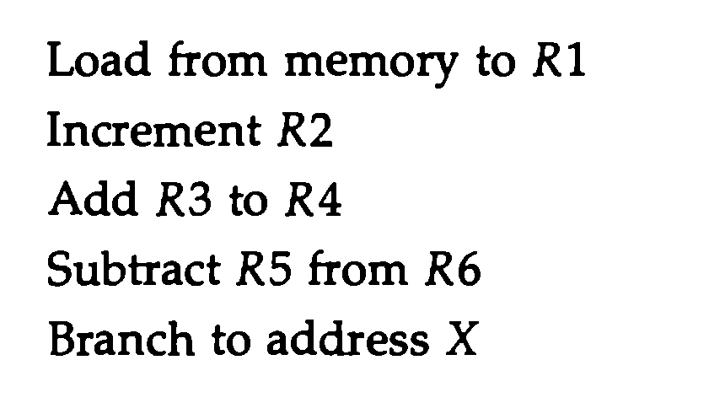
EXAMPLE OF DELAYED BRANCH
Based on M. Morris Mano “Computer System Architecture”-- Lecturer Ahmed Salah Hameed

Slide 34
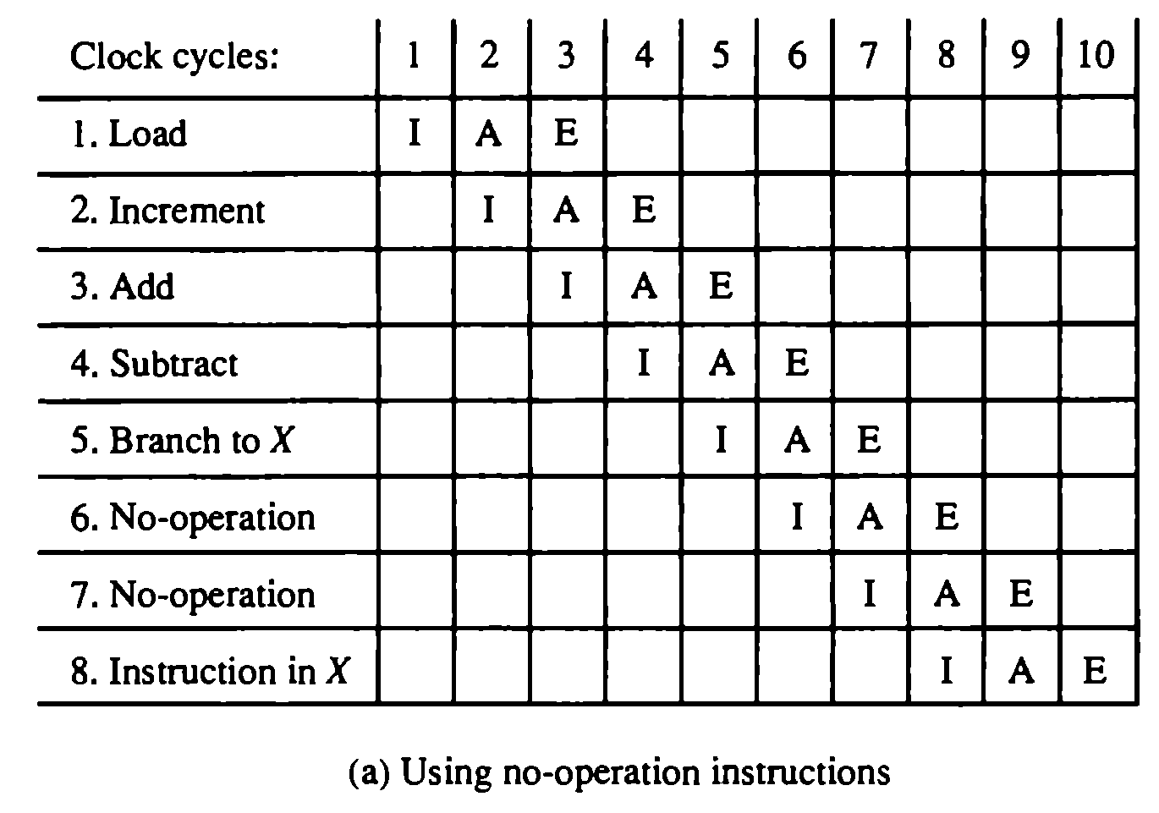
EXAMPLE OF DELAYED BRANCH
Based on M. Morris Mano “Computer System Architecture”-- Lecturer Ahmed Salah Hameed

Slide 35
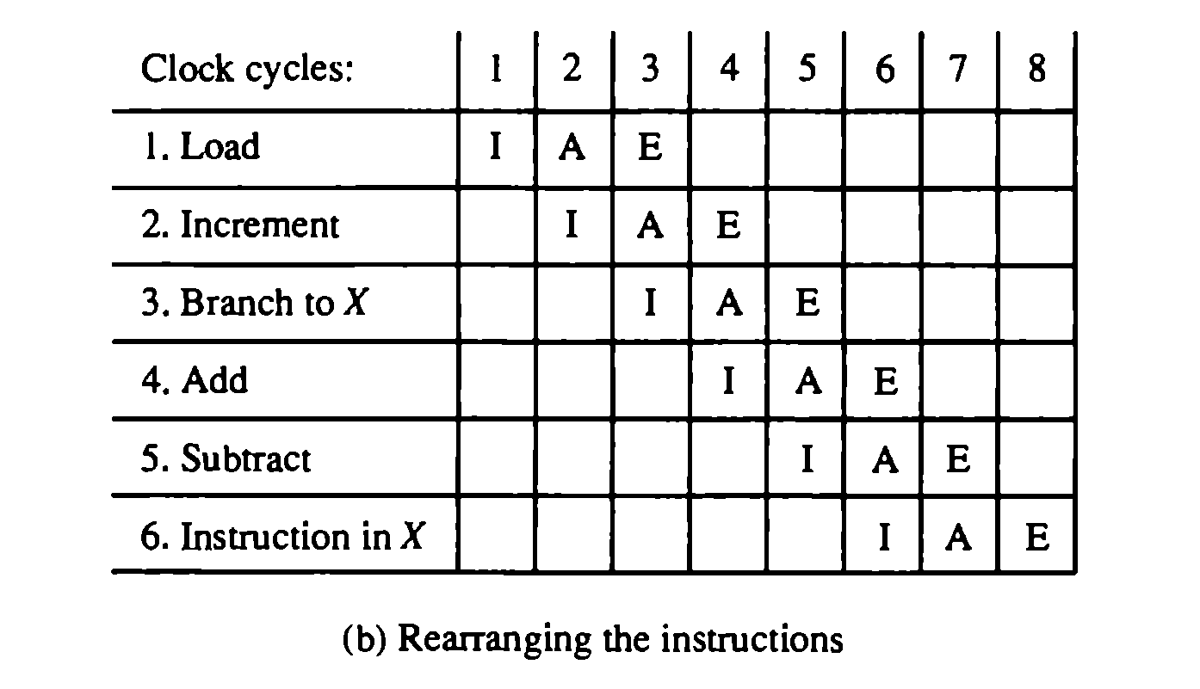
EXAMPLE OF DELAYED BRANCH
Based on M. Morris Mano “Computer System Architecture”-- Lecturer Ahmed Salah Hameed

Slide 36
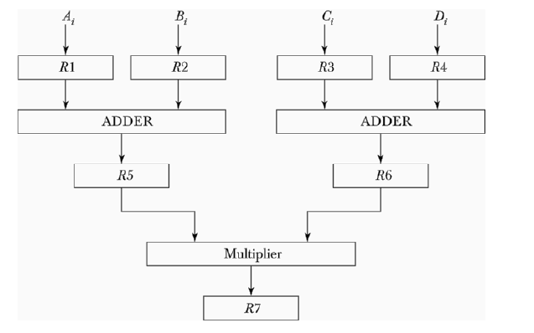
PROBLEMS
Based on M. Morris Mano “Computer System Architecture”-- Lecturer Ahmed Salah Hameed

Slide 37
PROBLEMS
Based on M. Morris Mano “Computer System Architecture”-- Lecturer Ahmed Salah Hameed

Slide 38
PROBLEMS
Based on M. Morris Mano “Computer System Architecture”-- Lecturer Ahmed Salah Hameed

Slide 39
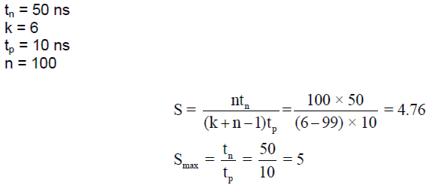
PROBLEMS
Based on M. Morris Mano “Computer System Architecture”-- Lecturer Ahmed Salah Hameed

Slide 40
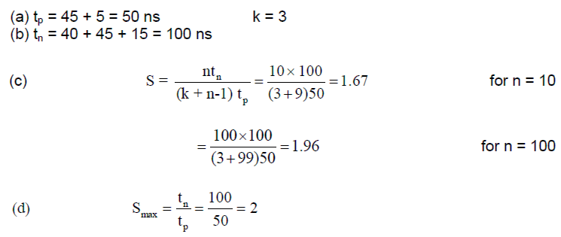
PROBLEMS
Based on M. Morris Mano “Computer System Architecture”-- Lecturer Ahmed Salah Hameed

Slide 41
PROBLEMS
Based on M. Morris Mano “Computer System Architecture”-- Lecturer Ahmed Salah Hameed

Slide 42
PROBLEMS
Based on M. Morris Mano “Computer System Architecture”-- Lecturer Ahmed Salah Hameed

Slide 43
PROBLEMS
Based on M. Morris Mano “Computer System Architecture”-- Lecturer Ahmed Salah Hameed

Slide 44
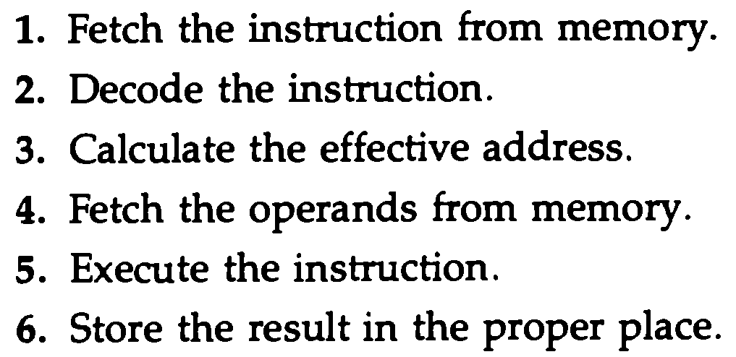
PROBLEMS
Based on M. Morris Mano “Computer System Architecture”-- Lecturer Ahmed Salah Hameed

Slide 45
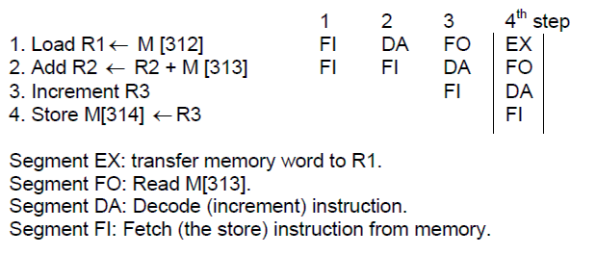
PROBLEMS
Based on M. Morris Mano “Computer System Architecture”-- Lecturer Ahmed Salah Hameed

Slide 46
PROBLEMS
Based on M. Morris Mano “Computer System Architecture”-- Lecturer Ahmed Salah Hameed

Slide 47
PROBLEMS
Based on M. Morris Mano “Computer System Architecture”-- Lecturer Ahmed Salah Hameed

